Slide 1
ENGLISH GRADE 4
TRUNG TU PRIMARY SCHOOL
SCHOOL YEAR: 2019 - 2020
UNIT 12:
WHAT DOES YOUR FATHER DO?
(continue)

Slide 2
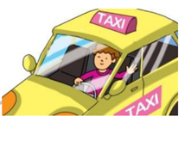
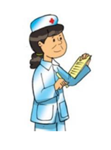
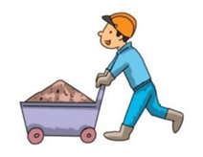
Ex 1: Look and write.
1. keclr → _ _ _ _ _
2. trodoc → _ _ _ _ _ _
3. dirvre → _ _ _ _ _ _
c l e r k
d o c t o r
d r i v e r
4. rusen → _ _ _ _ _
w o r k e r
n u r s e
5. rowker → _ _ _ _ _ _

Slide 3
Ex 2: Read and match.
1. What does your mother do? | A. He works in an office.
2. Where does she work? | B. He’s a clerk.
3. Does she work in a field? | C. She works in a hospital.
4. What does your father do? | D. She’s a nurse.
5. Where does he work? | E. No, she doesn’t.

Slide 4
Ex 3: Read and write the correct words next to their descriptions.
ball; water; clock; birthday cake; Children's Day
1. You can know the time when you look at it. ………….……...
2. We need it when we play football. …………………
3. I am very thirsty. I want to drink it. .………………..
4. People often eat it on their birthday. .………………...
5. It is the day for children. .………………...
clock
ball
water
birthday cake
Children’s Day

Slide 5
Ex 4: Read and choose the answer A, B or C.
1. His father is a ________.
A. teacher | B. doctor |  | C. student
2. He works in _______ Hospital.
A. Kim Lien | B. Thang Long |  | C. St. Paul
3. His mother teaches English at a _________.
A. primary school | B. secondary school | B. secondary school | C. university
4. His sister is a _________ .
A. teacher | B. student |  | C. pupil
5. Liam studies at his ________.
A. mother’s school | B. father’s school | B. father’s school | C. parents’ school
My name is Liam. I’m ten years old. There are four people in my family. My parents, my sister and me. My dad is a doctor. He works in St. Paul Hospital. My mum is a teacher. She teaches English at Kim Lien Primary School. My sister is a student of Thang Long University. I am a pupil at my mum’s school. I love my family.

Slide 6
Ex 5: Put the words in the correct order to make sentence.
1. is / factory / a / my / worker / uncle /.
 My uncle is a factory worker.
2. a / in / car / he / works / factory /.
 He works in a car factory.
3. do / mother / your / does / what /?
 What does your mother do?
4. work / she / does / where / ?
 Where does she work?
5. brother / your / what / do / does / ?
 What does your brother do?

Slide 7
Do you have all the correct answers?
Hope you have great time at home!
See you later!

