Slide 1
3
UNIT 13:
WHERE’S MY BOOK?

Slide 2
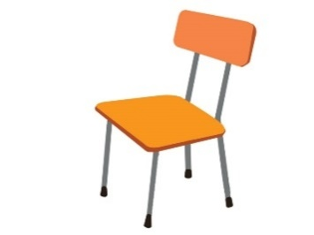
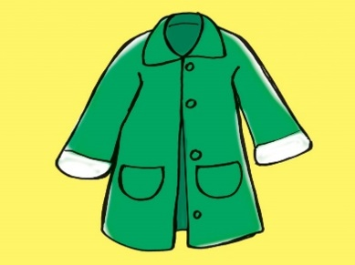
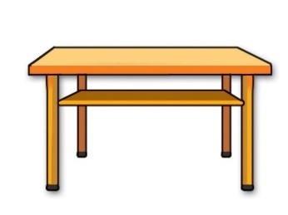
Task 1: Look and write.
1. irahc → c _ _ _ _
h a i r
2. atco → c _ _ _
3. rodo → d _ _ _
o a t
o o r
a b l e
5. labl → b _ _ _
4. labet → t _ _ _ _
a l l

Slide 3
Task 2: Reorder the words to make sentence.
1. colour/ is/ ruler/ what/ the ?
 What colour is the ruler?
2. how/ father/ is/ old/ your?
 How old is your father?
3. yellow/ the/ is/ bag/ school.
 The school bag is yellow.
4. is/ where/ book/ the?
 Where is the book?
5. rubber/ here/ is/ my.
 My rubber is here.

Slide 4
Task 3: Read and complete.
house | isn’t | it | garden | nice | there
A: This is my (0) house.
B: Wow. It's very (1) ____________.
A: Yes, (2) ________ is. And this is my bedroom.
B: It's so big! Is there a (3) ___________?
A: Yes, (4)___________ is. Come and see it.
B: Is there a pond in the garden?
A: No, there (5)__________.
nice
it
garden
there
isn’t

Slide 5
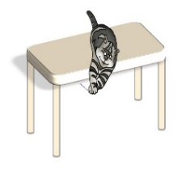
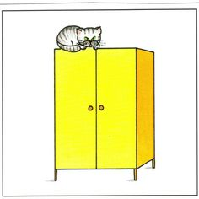
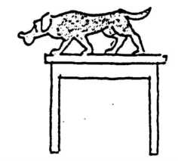
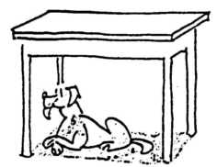
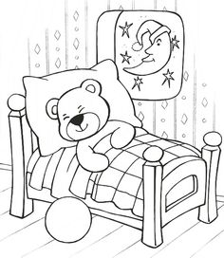
Task 4: Look, read and circle the correct picture.
1. A B | 1.The cat is on the closet.
2. A B | 2. The dog is on the table.
3. A B | 3. The teddy bear is on the bed.
(tủ quần áo)

